Slide 1
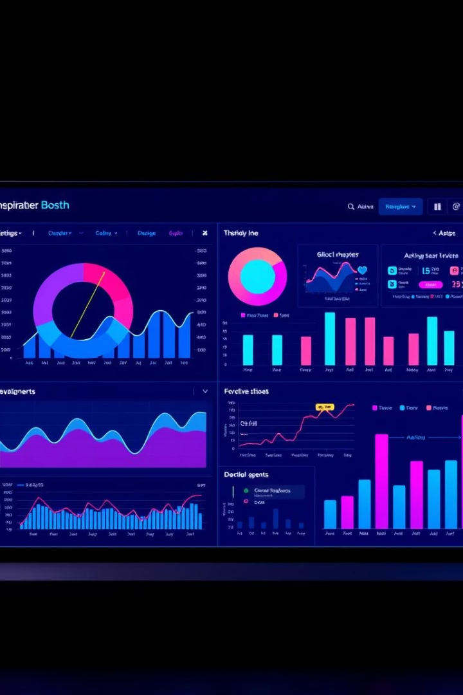
Interactive Sales Dashboard for Business Stakeholders
Tableau + Superstore Sales
Presented by Omlal Kantekar

Slide 2

Dashboard Objective
This dashboard provides actionable insights. It helps stakeholders understand sales and profitability.
It enhances data-driven decisions. It focuses on regional, product, and segment analysis.
Insights
Decision-Making
Actionable insights into sales performance and profitability
Enhance data-driven decision-making
Focus
Focus on regional, product, and segment-based analysis

Slide 3
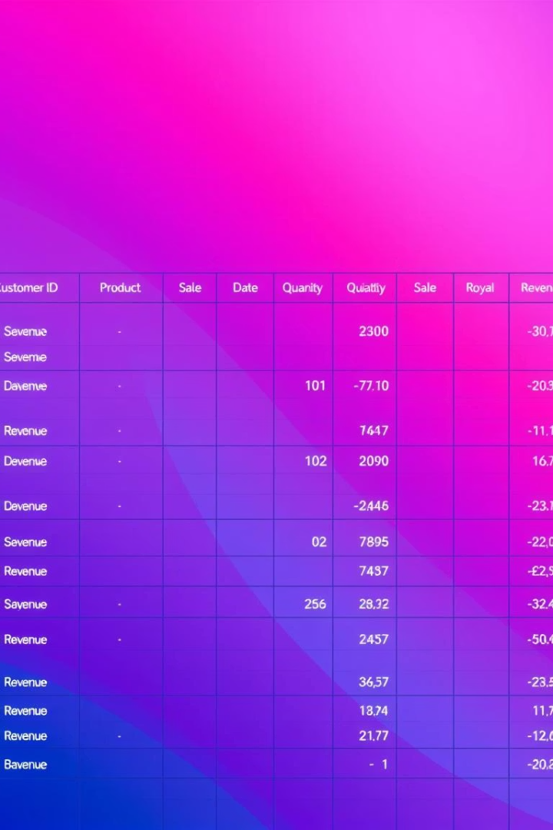
Dataset Overview
The dataset source is Tableau's Sample - Superstore dataset.
It has 10+ fields: Sales, Profit, Quantity, Region, and Category.
The scope includes 4 years of fictional retail business data.
Data Source
Key Fields
Tableau Superstore dataset.
Sales
Profit
Region
Category
Data Scope
4 years of retail data

Slide 4
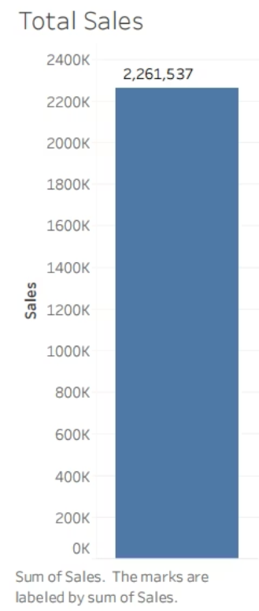
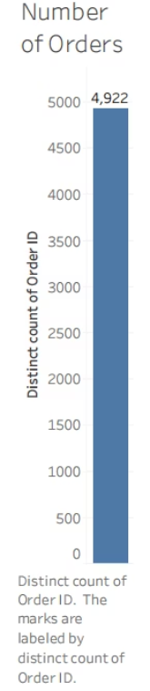
Sheet 1 & 2 :Total Sales & Number of Order

Slide 5
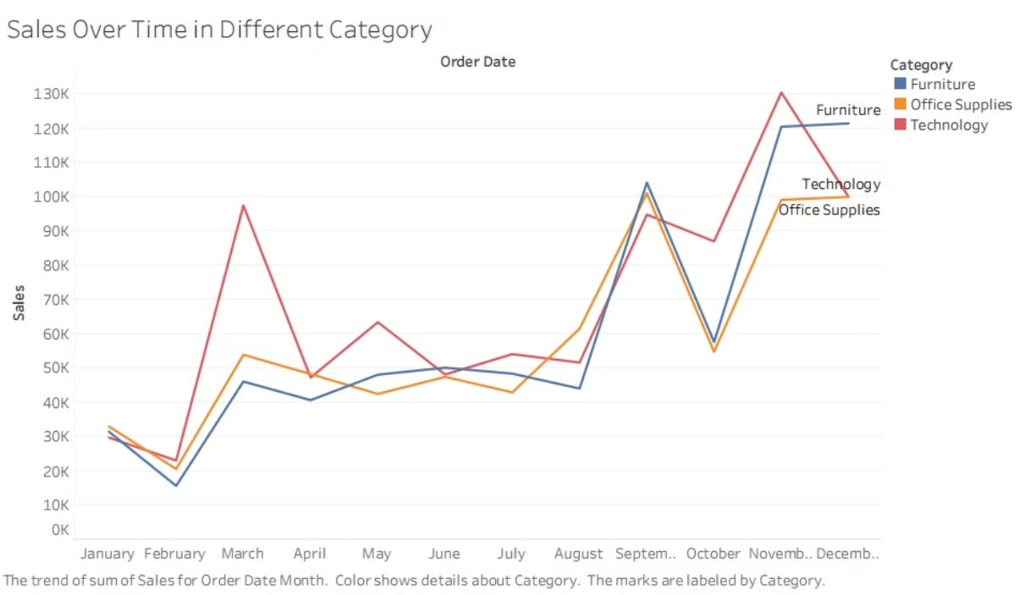
Sheet 3:Sales Over Time in Different Category

Slide 6
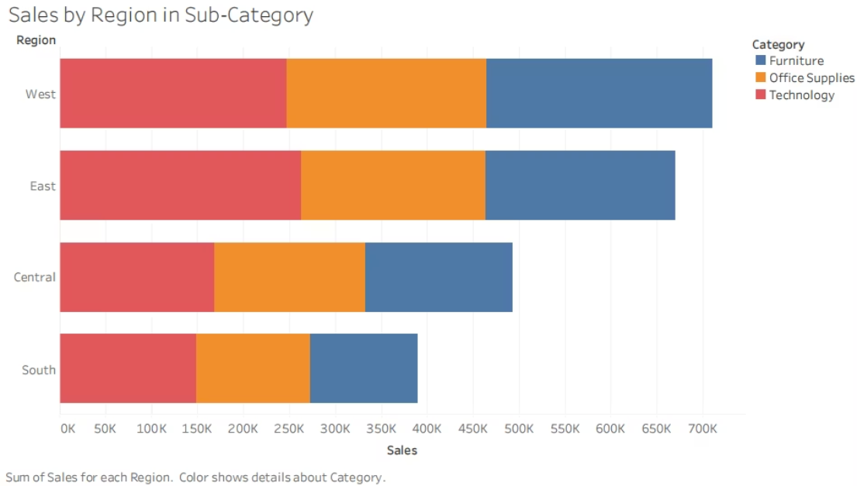
Sheet 4: Sales by Region in Category

Slide 7
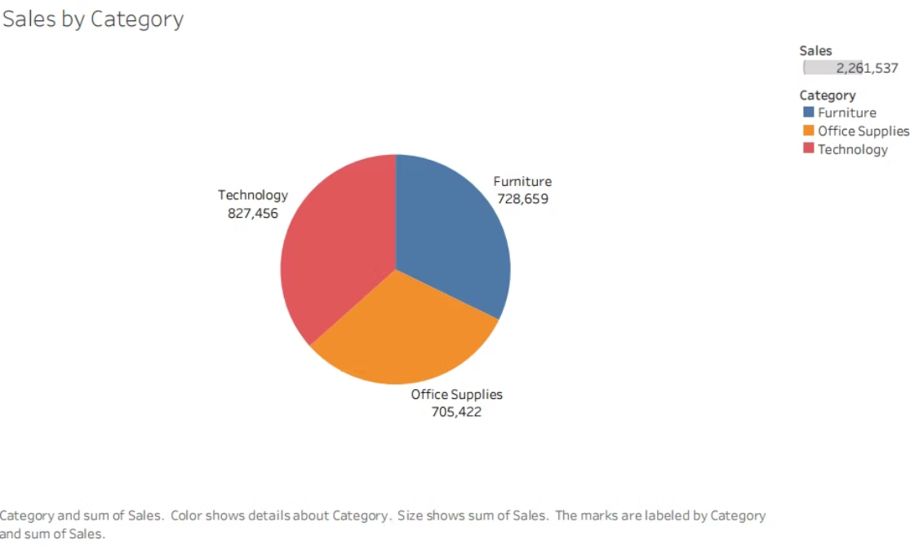
Sheet 5: Sales by Category

Slide 8
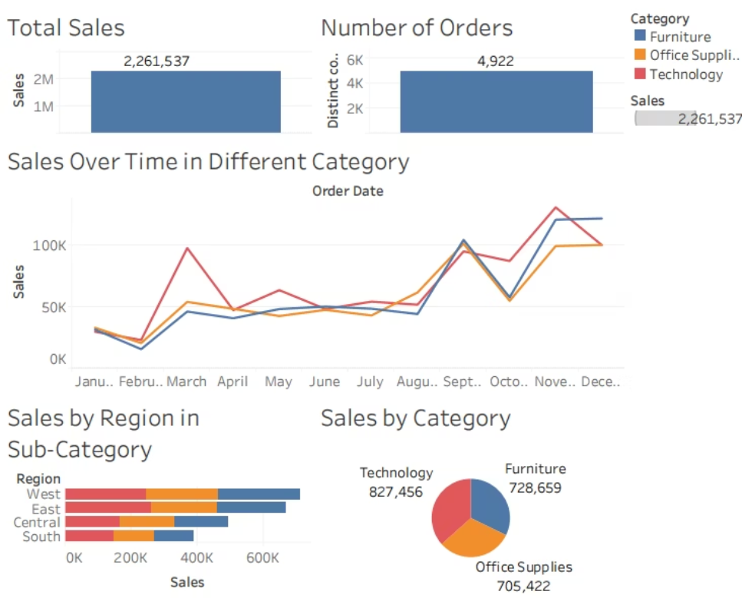
Dashboard

Slide 9



Key Insights and Findings
Technology drives 42% of total sales, showing highest profitability.
California and New York dominate sales by state. Consumer segment accounts for 60% of overall sales.
California & New York
Top sales by state
Technology
Consumer Segment
42% of sales
60% of sales
2
1
3

Slide 10

Conclusion
The Dashboard enables in-depth sales and profitability analysis.
It encourages targeted strategies by region and product category.
Future work: Advanced dashboards to track customer loyalty.

